Slide 1

HOW TO UNBLUR YOUR PICTURE USING Remini Presented by: GROUP 4
~ free version

Slide 2


Members:
- Tionusa Catur Pamungkas (2341720093)
- Tyara Kusuma Nevada (2341720019)
- Dandi Azrul Syahputra (2341720118)
GROUP 4

Slide 3
Table of Contents:
What is Remini
How to unblur your picture using Remini
Why you have to use Remini than other App
Conclusion

Slide 4

Remini is one of the most popular and beloved photo-enhancement apps in the world. Remini has an advanced AI technology to improve the quality of old blurry photos in your photo gallery. The application can restore and colorize black and white or historical pictures with astounding clarity and precision.
What is Remini

Slide 5
HOW TO UNBLUR YOUR PHOTO USING REMINI as

Slide 6
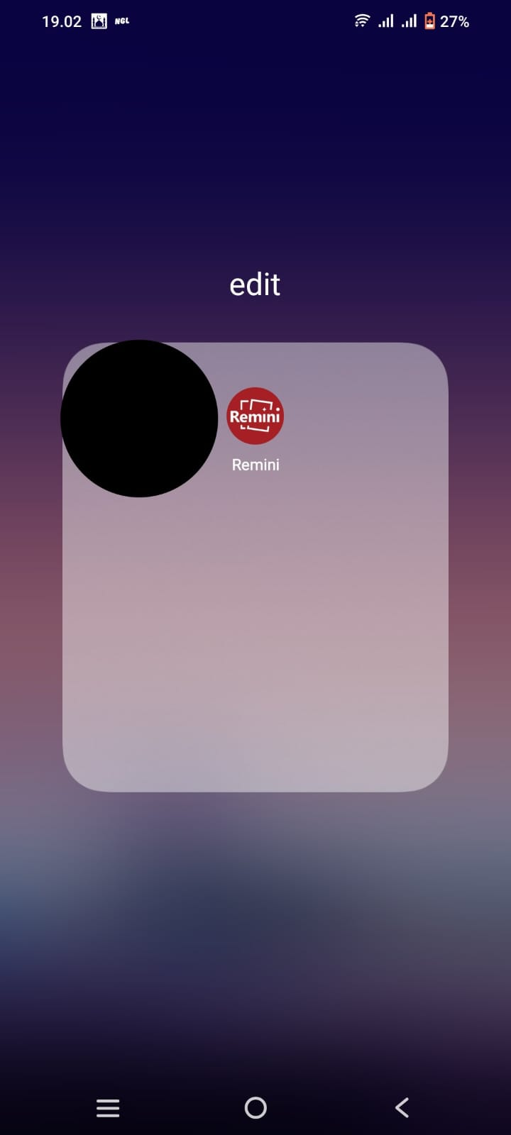
First of all, open your Remini app.

Slide 7
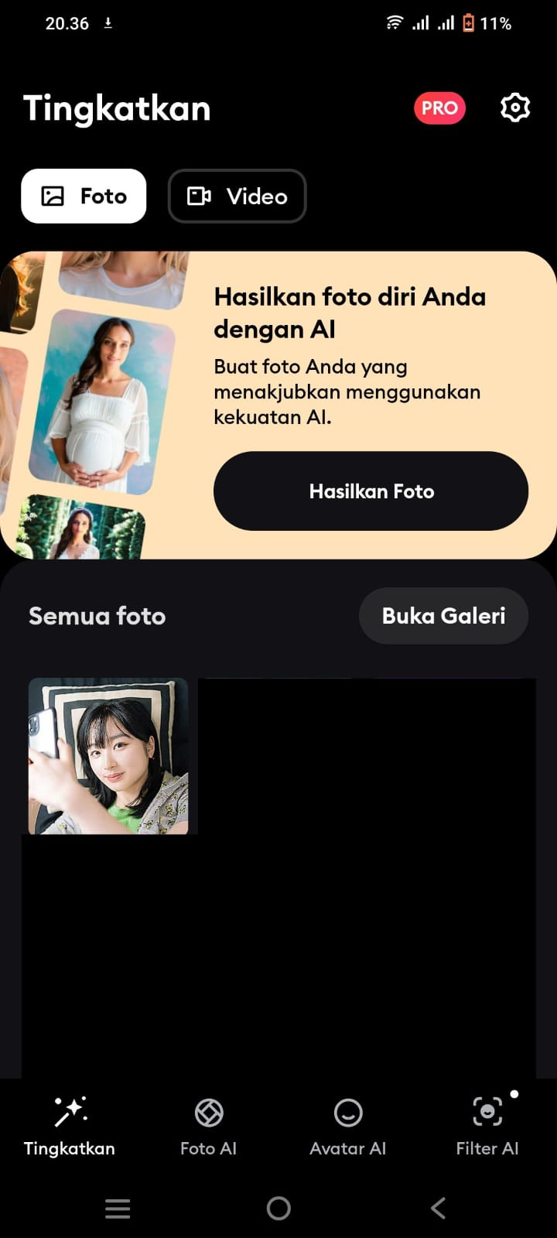

After you open the app, Press the “Tingkatkan” button and the app will take you to your gallery.

Slide 8
Select the image you want to unblur.

Slide 9
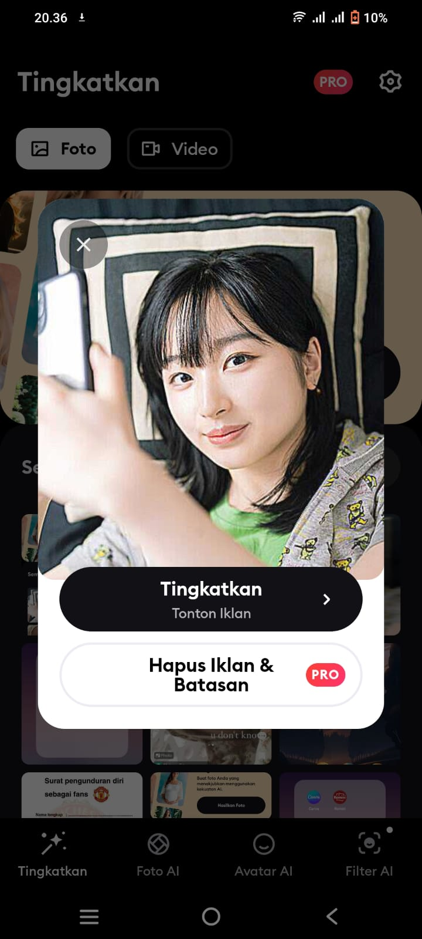
After picking a photo, a pop up will appear, then press the “Tingkatkan” button.

Slide 10

x
Before you get the final result, you have to watch an ad. Then, you can click the cross button at the top right corner.

Slide 11
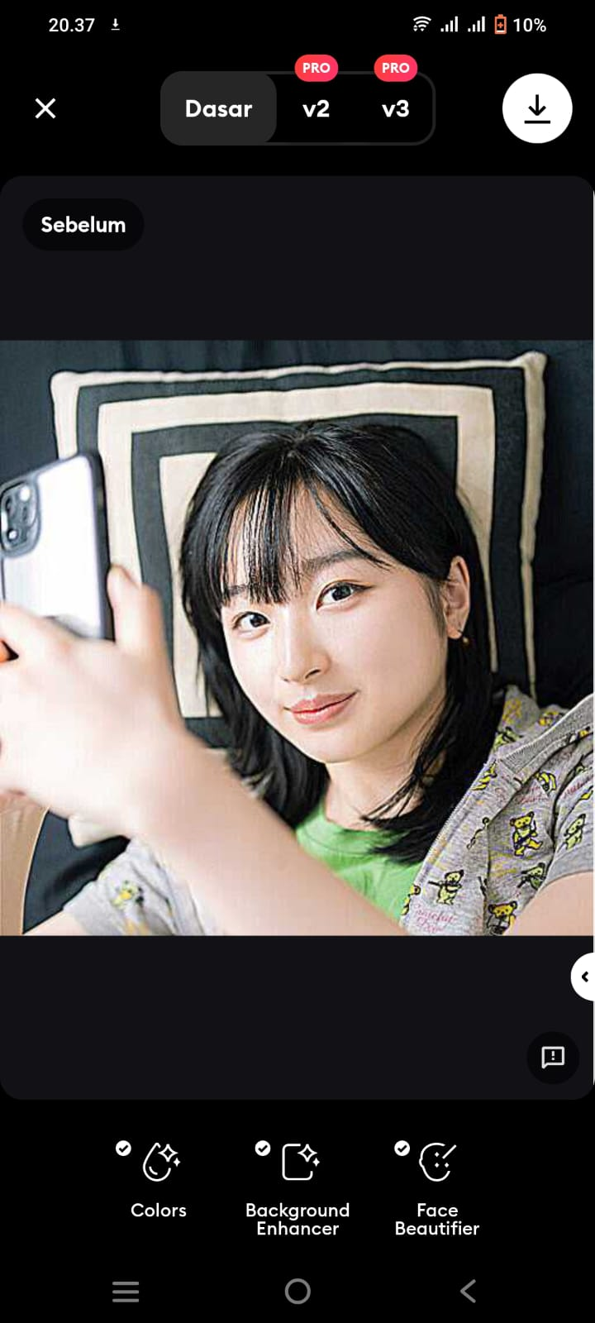
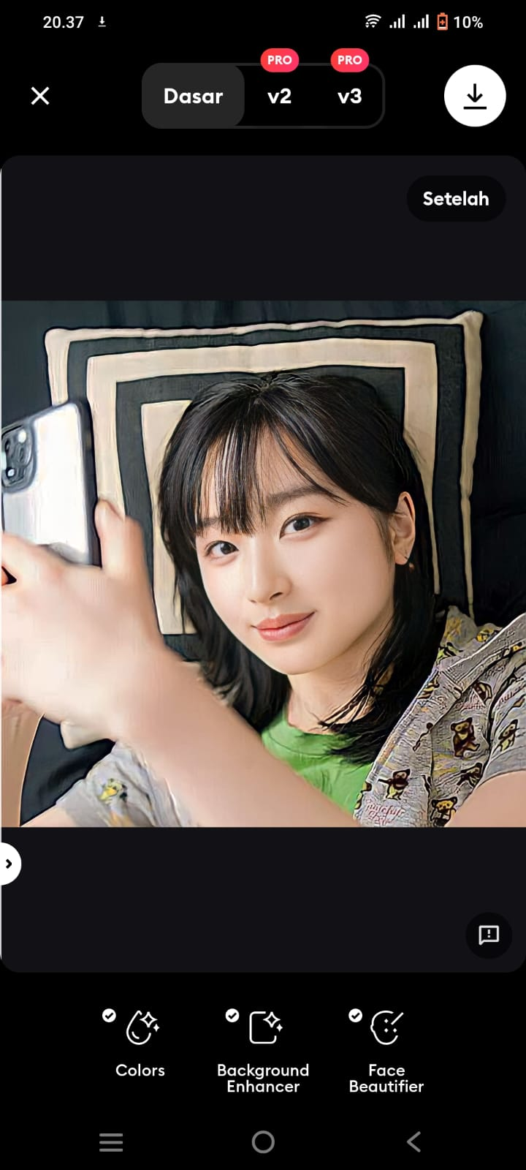
Finally, the image you selected has been unblurred.
Before
After

Slide 12
Why you have to use Remini than other App (B612)

Slide 13
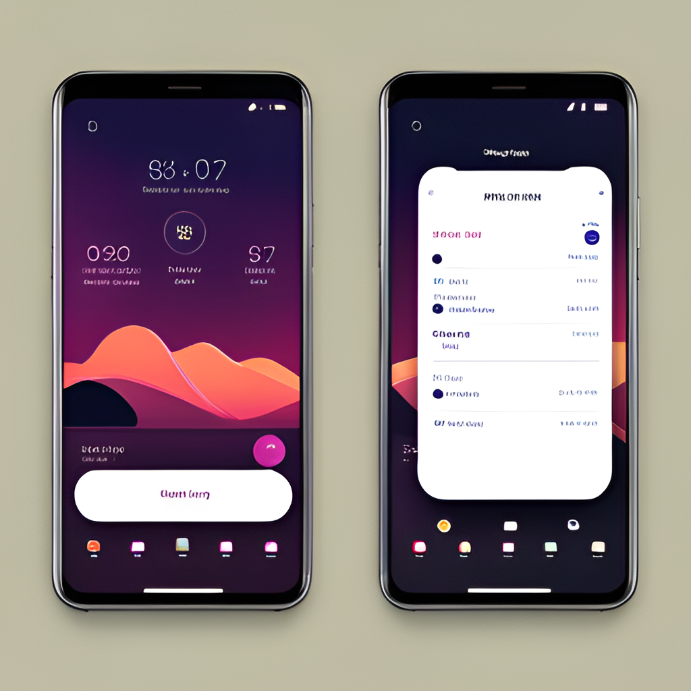
User Interface
Remini and B612 have very different user interfaces. Remini's interface is more minimalist, with a focus on simplicity and ease of use. The main menu consists of only a few options, making it easy to navigate. In contrast, B612 has a more complex interface, with many options and settings to choose from. This can be overwhelming for some users.

Slide 14

Pricing
Remini and B612 are both available for free download on the App Store and Google Play Store.
However, Remini offers a limited number of free photo enhancements per day, and users must purchase credits to unlock additional enhancements. The cost of credits ranges from $0.99 for 30 credits to $49.99 for 1500 credits.
On the other hand, B612 offers in-app purchases for additional filters and stickers. Prices range from $0.99 to $7.99 per item.

Slide 15

User Reviews
Remini has received mixed reviews from users. Some praise its AI-powered photo enhancement technology, which can restore old photos and improve the quality of blurry images. Others criticize the app for being too expensive or not delivering on its promises. According to the App Store, Remini has a rating of 4.5 stars out of 5, based on over 50,000 reviews.
B612, on the other hand, is highly rated by users for its real-time beauty filters and AR stickers. Many users appreciate the app's ease of use and the variety of features it offers. However, some have complained about the app crashing or freezing. B612 has a rating of 4.7 stars out of 5, based on over 2 million reviews on the App Store.

Slide 16

Which App is Better?
After careful consideration of the user interface, and pricing, we recommend Remini as the better photo editing app. While B612 has some great features such as real-time beauty filters and AR stickers, Remini's AI-powered photo enhancement technology and ability to restore old photos set it apart from other apps.
In addition, Remini's user interface is intuitive and easy to navigate, making it accessible for users of all skill levels. And while both apps offer a free version, Remini's paid version offers more advanced features at a reasonable cost.
Remini is better than B612 as

Slide 17
CONCLUSION

Slide 18

Conclusion
In conclusion, both Remini and B612 are impressive photo editing apps that offer unique features to enhance your photos. Remini's AI-powered photo enhancement technology and ability to restore old photos make it a standout choice for those looking to improve their photo quality. On the other hand, B612's real-time beauty filters and AR stickers provide a fun and creative way to personalize your photos.
After careful consideration, we recommend Remini as the better option for serious photo editing. While B612 offers some great features, Remini's advanced technology truly sets it apart from other photo editing apps. With Remini, you can transform your old, grainy photos into stunning, high-quality images that you'll be proud to share with others. So why settle for anything less? Download Remini today and take your photos to the next level!

Slide 19
Thank you,
Do you have any questions?
-Group 4

